Slide 1


Portugal
PREPARED BY: Weronika Chałatkiewicz, Ola Marianowska, Kuba Oniszk, Kalina Paska, Kasia Petru, Hubert Stevnert
GIMNAZJUM PRZYMIERZA RODZIN/PRZYMIERZE RODZIN MIDDLE SCHOOL

Slide 2
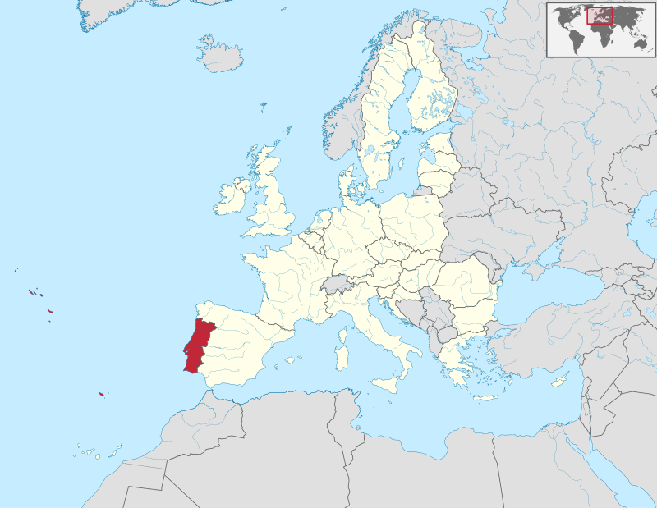
LOCATION

Slide 3
BASIC INFORMATIONS
Population: 10,8 milion
Area: 92 391 km²
Capital city: Lisbon
Official language: Portuguese
Currency: Euros €

Slide 4
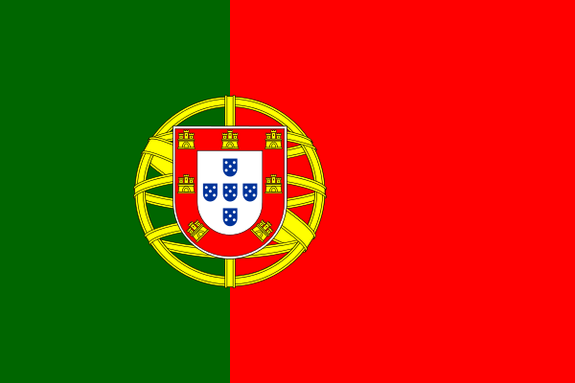
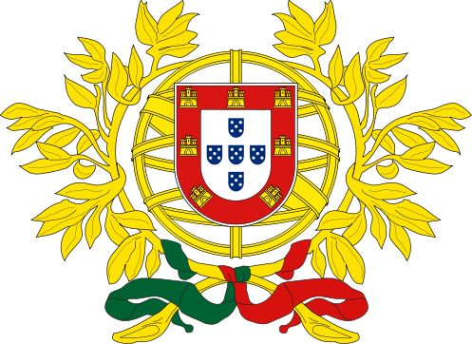
NATIONAL SYMBOLS

Slide 5
HISTORY
Ancient times the lands of present Portugal were inhabited by the Celts and Iberians.
In the third century BC, the territory was under the sovereignty of Carthage.
In the next century they became a Roman territory.

Slide 6
HISTORY
From 5th century to 8th they were under German control.
In 718 Portugal was conquered by Muslims.
In 1097 they separated the new territory Portucale.

Slide 7
HISTORY
In 1139 Alfons Henry’ became the King of Portugal and received an independence of his country.
Since 1249 after getting the Algarve coast Portugal have the same borders.
The greatest time’s of the history of Portugal were during the Age of Discovery.

Slide 8
HISTORY
In 1580 Spain’s monarchy took over the Portugal’s monarchy.
1640 – revolution and getting back the independence.
Portugal never get back its power and greatness.

Slide 9
HISTORY
In 1910 Portugal became a republic.
1926 was the year of coup d’état. António de Oliveira Salazar became the prime minister.
In 1933 new constitution was formed. It created „Estado Novo” – authoritarian country under Salazar’s reigime.

Slide 10
HISTORY
1974 – Carnation Revolution which get Portuguese people democratical system.
In 1986 Portugal became a part of EU.
In 2002 Portugal changed its currency to euros.

Slide 11
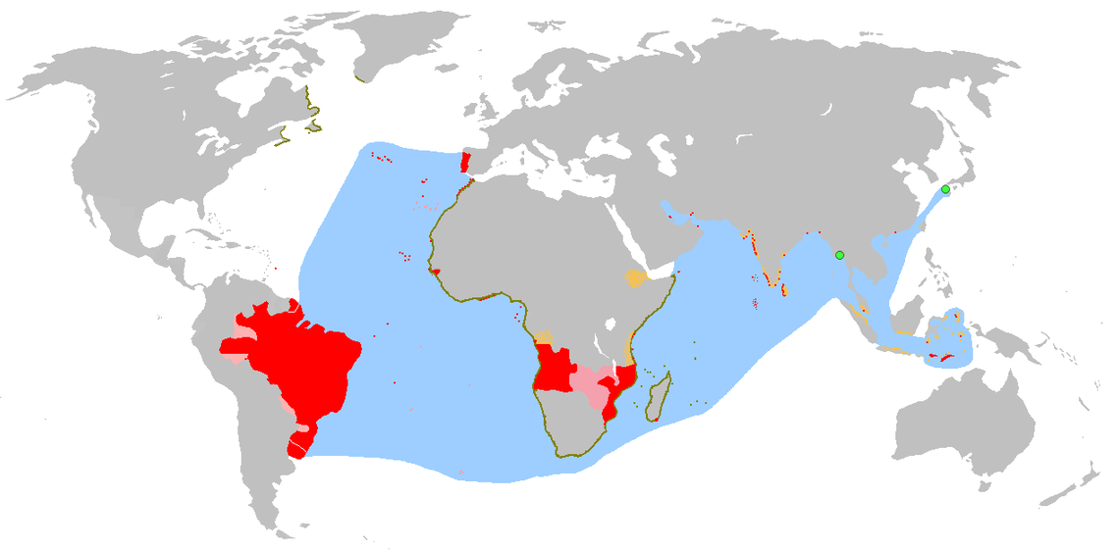
PORTUGUESE COLONIAL EMPIRE

Slide 12
PORTUGUESE COLONIAL EMPIRE
Brazil
Angola
Mozambique
St Helena
Cabo Verde
Timor-Leste
Macau
Uruguay
Madeira & Azores

Slide 13
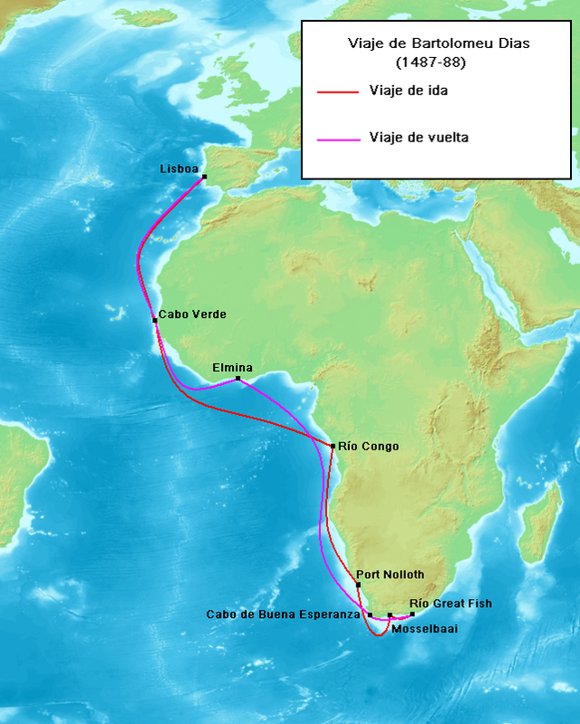
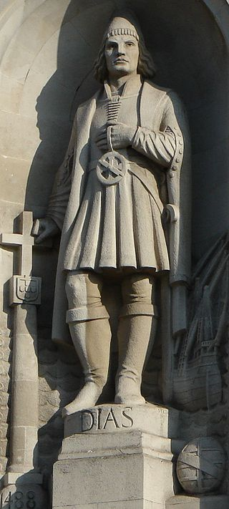
Bartolomeu Dias

Slide 14
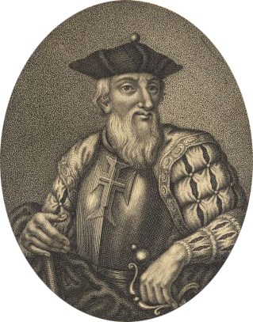
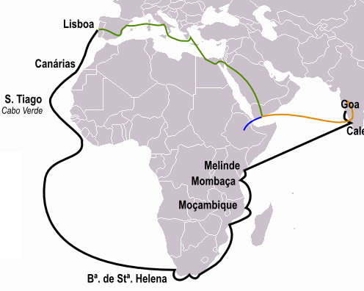
Vasco Da Gama

Slide 15
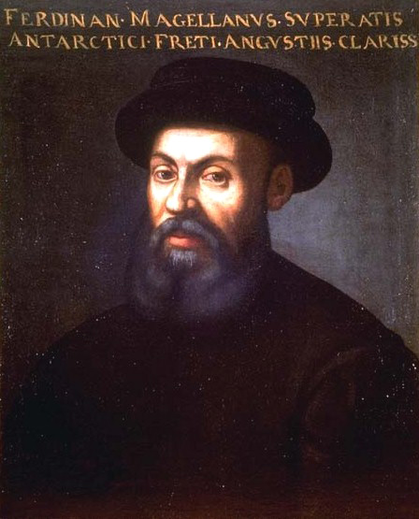
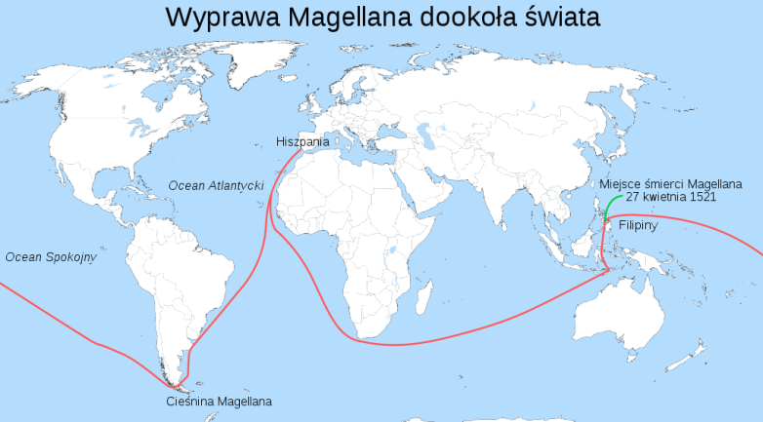
Ferdinand Magellan

Slide 16
CULTURE
In the culture of Portugal we can find some influence from the other civilizations. For example, from those, with which the Portuguese had a contact, during the Age of Discovery
Portugal is home to 13 UNESCO World Heritage Sites, from which 9 are the architecture monuments and the other 2 are the wine growing regions
The culture of the Portugal is a little bit related to their neighbor, Spain.

Slide 17
ARCHITECTURE
The traditional architecture includes the Manueline, (Portuguese late Gothic), which is a ortuguese style of architectural ornamentation. The Manuelin was created during the Age of Discovery, in the reign of the king Manuel I.
Some great examples of the Manuelin architecture are: the Monastery of the Hieronimits, Belém Tower or Convent of Jesus Christ in Tomar.
In Portugal we can also find the modern architecture, for example Casa da Música.

Slide 18
ARCHITECTURE
Belém Tower
Monastery of the Hieronimits
Casa da Musica

Slide 19
MUSIC
The most famous music in Portugal is the one called Fado, it’s a melancholy type of music originated in Lisbon, usually associated with the Portuguese guitar
The most popular artist in this genre of music are: Amália Rodrigues, Carlos Humberto Paredes, José Afonso
Every summer in Portugal there are organized many special music events, for example the TMN Festival Sudoeste

Slide 20
LITERATURE
Portuguese literature, IS one of the earliest Western literatures, developed through texts, and the troubadours performances
Adventurer and poet Luís de Camões, who wrote the epic poem "Os Lusíadas" (The Lusiads) is known as one of the best portugal writer
Fernando Pessoa, was a great Modern Portuguese poetry
José Saramago, who won the Nobel Prize in Literature in 1988

Slide 21
LITERATURE
Luis de Camões
Jose Saramago

Slide 22
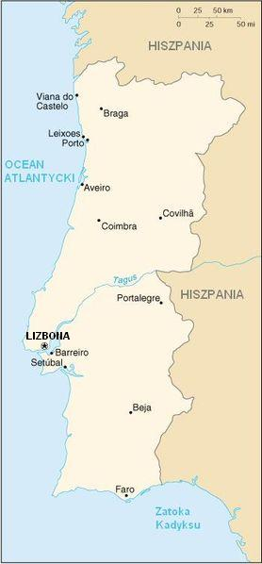
MAP

Slide 23
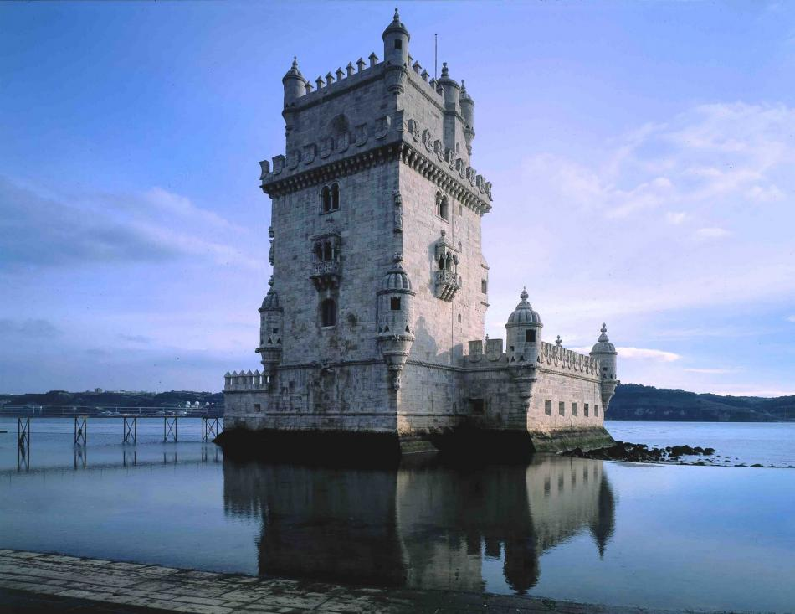
Belém Tower

Slide 24
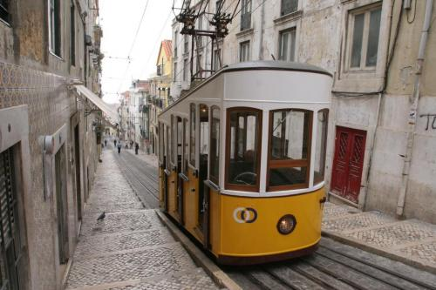
Tram line number 28

Slide 25
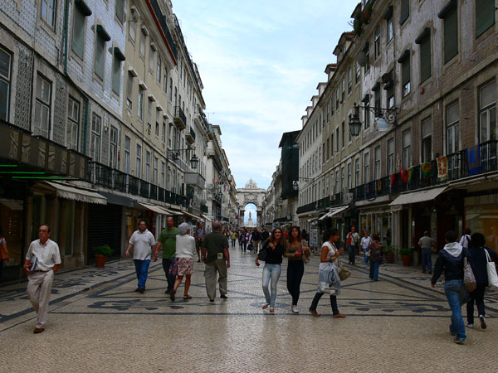
Baixa District

Slide 26
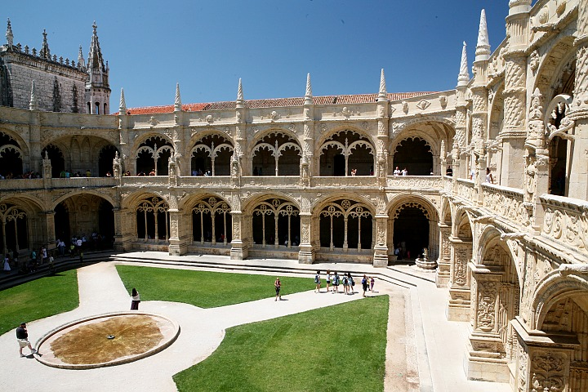
Jeronimós Monastery

Slide 27
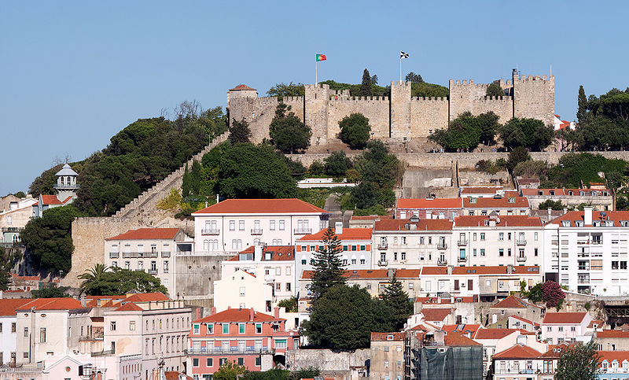
Castle of São Jorge

Slide 28
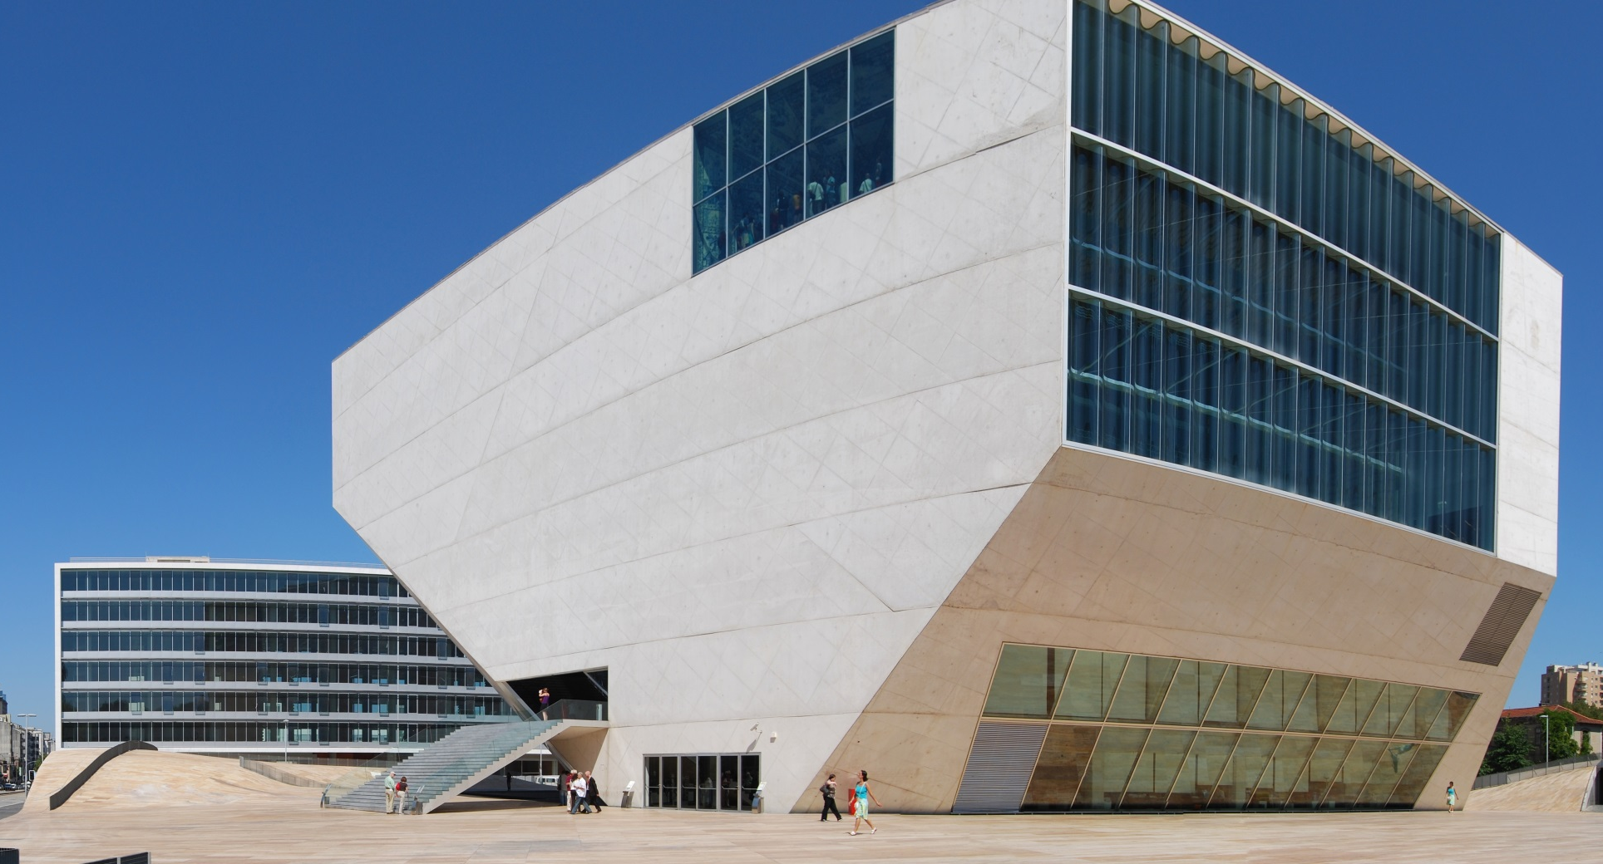
Casa da Musica Concert Hall

Slide 29
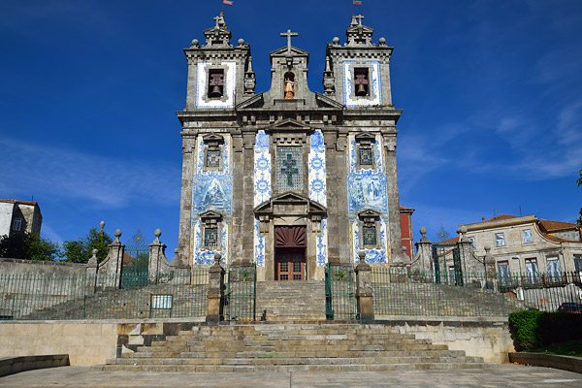
St Francis Church

Slide 30
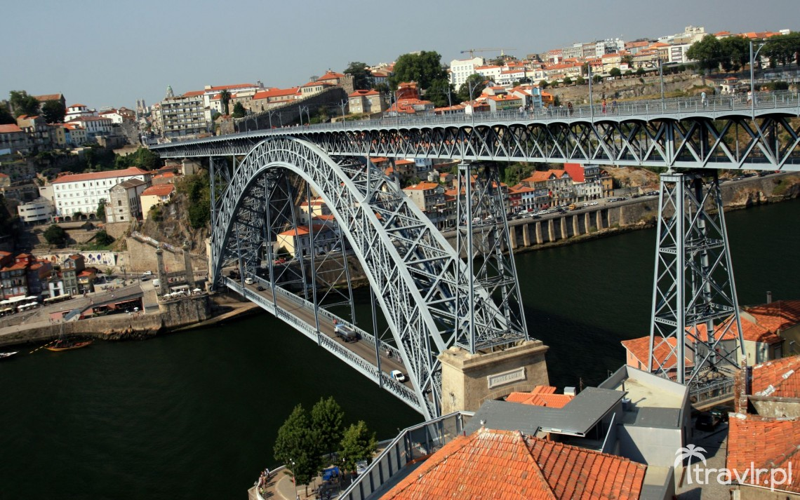
Ponte Dom Luís I Bridge

Slide 31
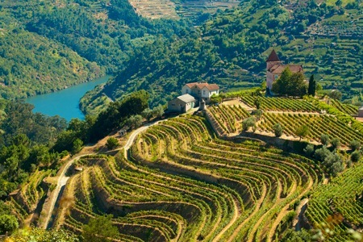
Porto Vineyards

Slide 32
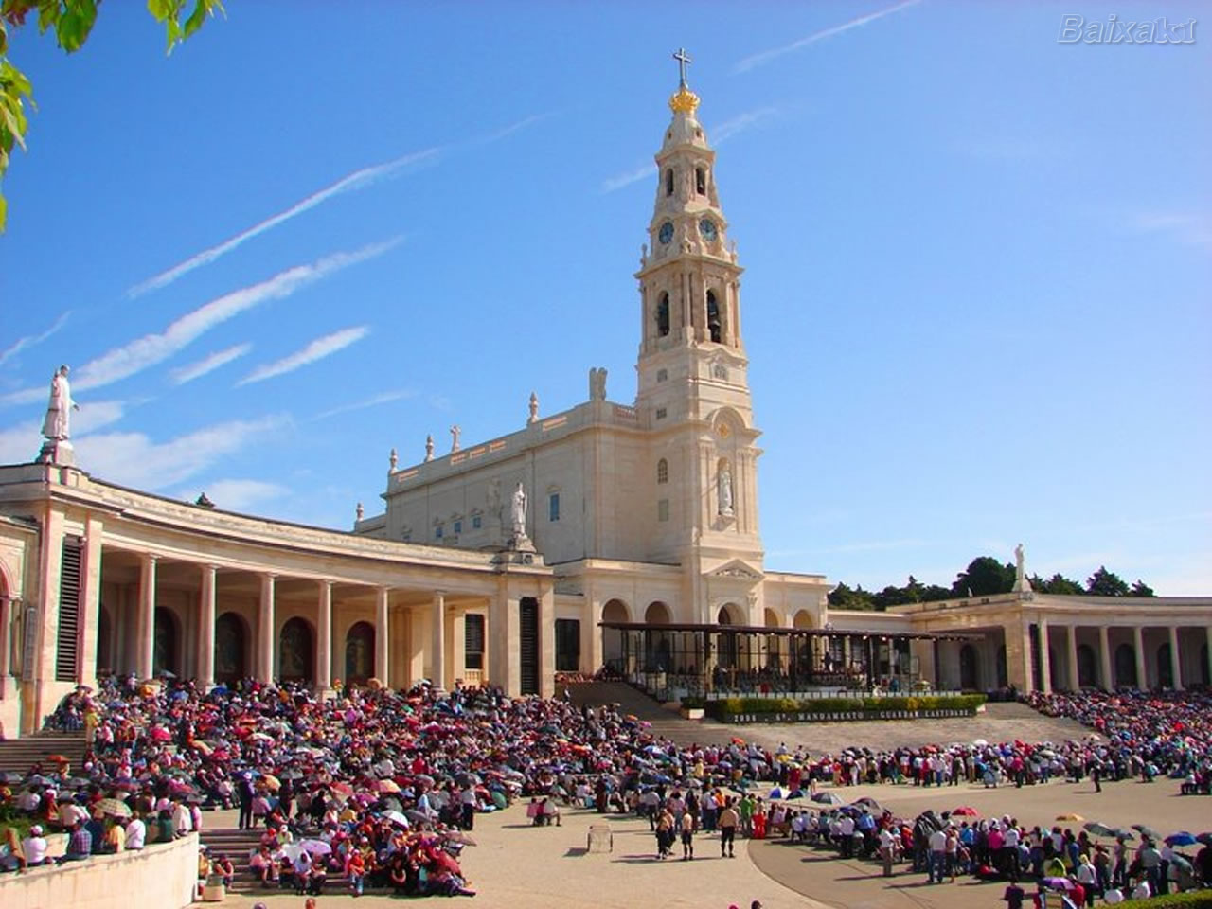
Fatima

Slide 33
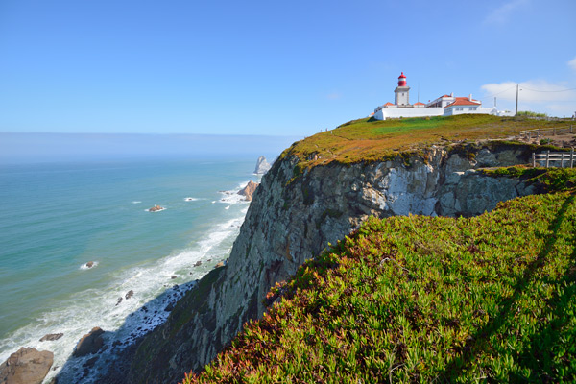
Cape Cabo da Roca

Slide 34
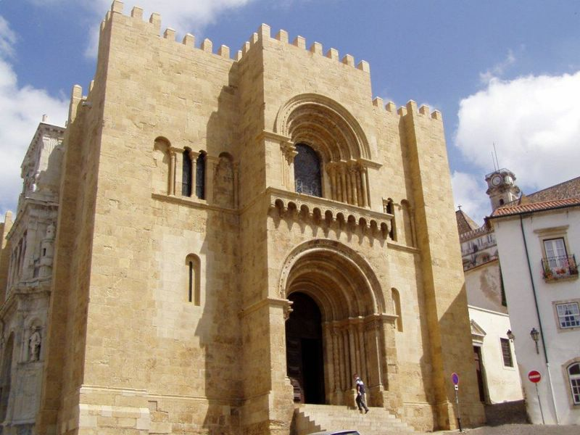
Old Cathedral of Coimbra

Slide 35
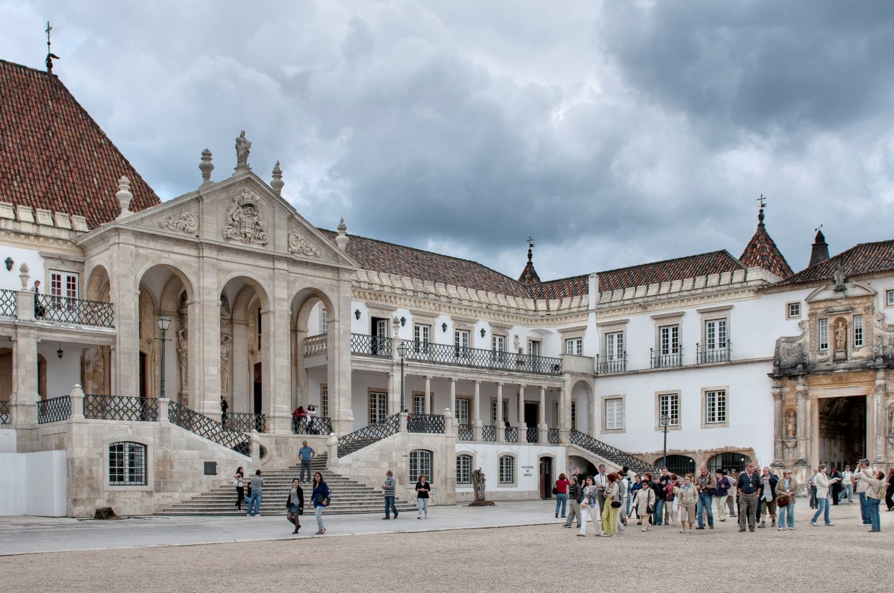
Coimbra University

Slide 36
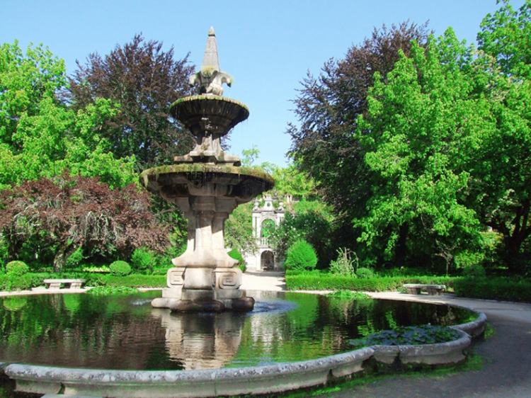
Botanical Garden of the University of Coimbra

Slide 37
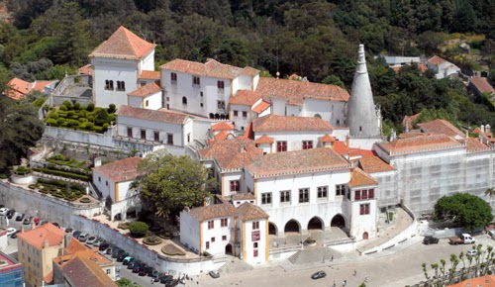
National Palace

Slide 38
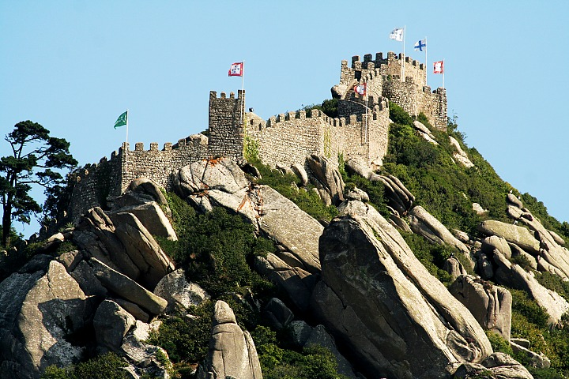
Castle of the Moors

Slide 39
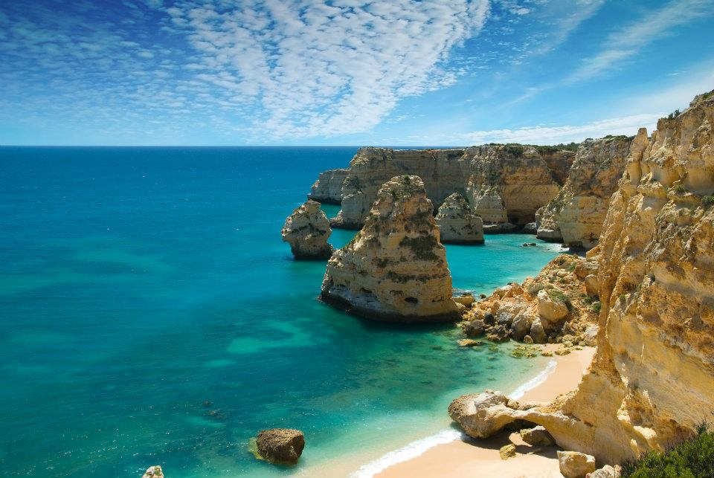
Algarve Coast

Slide 40
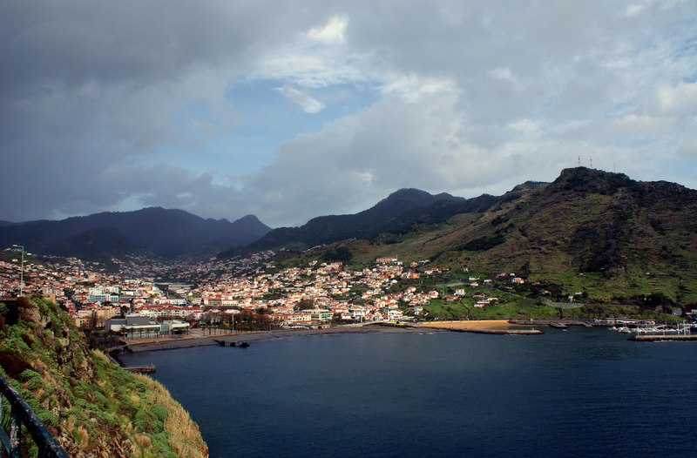
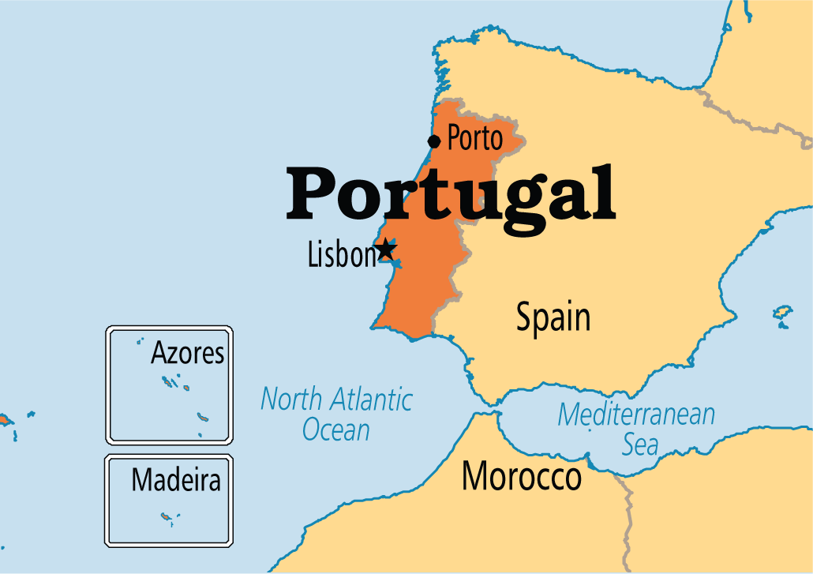
Madeira

Slide 41
SPORT
Portugal is known only from the summer disciplines.
The most popular sport in Portugal is football.
In Portugal in Estoril is a racing track, where F1 and MotoGP Grand Prixs were held.
The biggest cycling race in Portugal is Volta a Portugal.
At the seashore surfing is popular.

Slide 42
BIGGEST FOOTBALL CLUBS
SL Benfica
FC Porto
Sporting CP

Slide 43
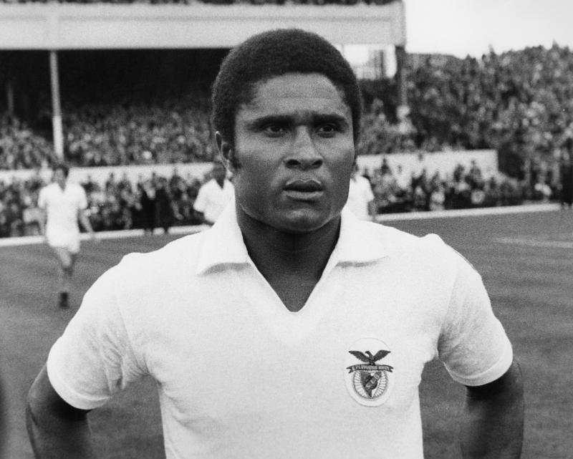
Eusebio

Slide 44
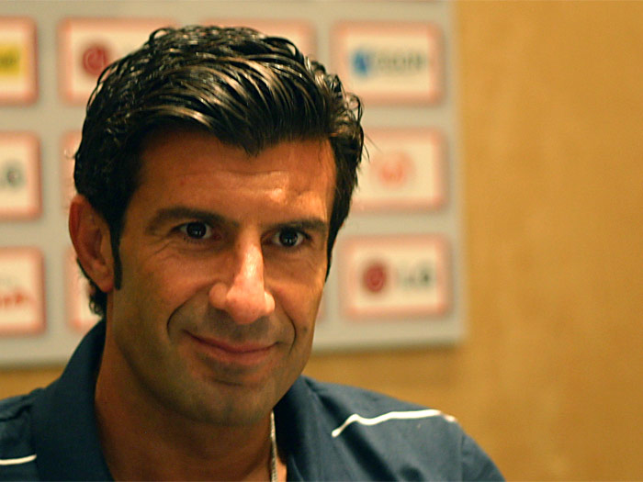
Luís Figo

Slide 45
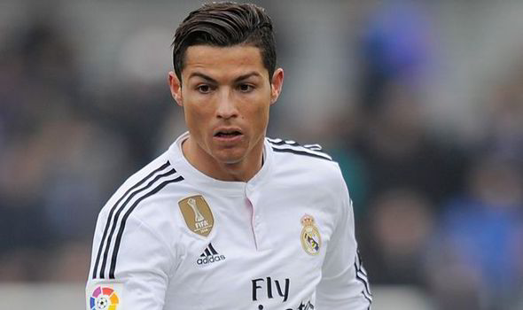
Cristiano Ronaldo

Slide 46
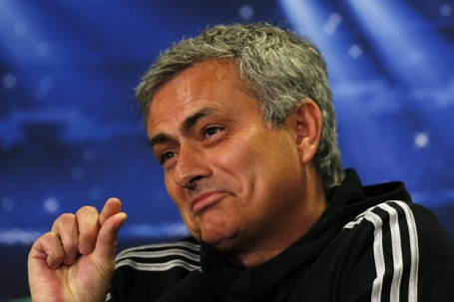
José Mourinho

Slide 47
FOOD
The variety of Portugal cuisine, comes from colonial routs and Japannese, Chinceesem, Indian and Brasilian cuisine heritage.
The dishes are simple, often seasoned with salt and olive oil.
Meat is often combined with seafood.
Dinner is usually served with the bottle of Portuguese wine.

Slide 48
MEAT
Bife
Pica-pau
Morcela frita com ananas

Slide 49
FISH
Bacalhau no Forto
Sardinhas Assadas
Salada de Bacalhau

Slide 50
SEAFOOD
Crab salad
Percebes

Slide 51
DESSERTS
Jesuitas
Ovos Moles
Bolo de Arroz

Slide 52
OTHER
Queijo Serra da Estrela
Queijo de Azeitão
Porto Wine

Slide 53
The End
Thank You for the attention!

Slide 54
Quiz
ABOUT PORTUGAL
GOOD LUCK!

Slide 55
WHAT IS THE NAME OF THE OCEAN WHICH IS NEAR PORTUGAL?
A: Indian Ocean
B: Atlantic Ocean
C: Pacific Ocean
D: Southern Ocean

Slide 56
WHICH OF THIS PLACES WERE PORTUGAL COLONIES?
A: New Guinea, Cape Verde, Paraguay
B: Japan, Angola, India
C: Azores, Macau, Mozambique
D: Timor-Leste, Brazil, China

Slide 57
WHAT IS THE NAME OF PORTUGUESE SAILOR WHO ARRIVED FOR THE FIRST TIME TO INDIA BY SEA?
A: Christopher Columbus
B: Henry the Navigator
C: Ferdinand Magellan
D: Vasco Da Gama

Slide 58
WHAT IS THE EXAMPLE OF PORTUGUESE MODERN DESIGN?
A: Casa Da Musica
B: National Palace
C: Baixa District
D: Belém Tower

Slide 59
WHICH COLOURS ARE ON THE NATIONAL FLAG OF PORTUGAL?
A: Green and Gold
B: Green and Red
C: Blue and Red
D: Black and Yellow

Slide 60
WHICH FOOTBALL CLUB IS FROM LISBON?
A: PSG
B: Chelsea
C: Sporting CP
D: Juventus

Slide 61
WHAT IS THE NAME OF FAMOUS PORTUGUESE FOOTBALL COACH?
A: Pep Guardiola
B: Louis van Gaal
C: José Mourinho
D: Jürgen Klopp

Slide 62
WHEN WAS THE CARNATION REVOLUTION?
A: 1974
B: 1999
C: 1926
D: 1950

Slide 63
HOW IS CALLED THE FAMOUS PORTUGUESE WINE?
A: Aloxe-Cortone
B: Porto
C:Constantia
D: Pateõs

Slide 64
WHICH OF THESE MONUMENTS IS LOCATED IN THE CAPITAL CITY OF PORTUGAL?
A: Ponte Dom Luís I Bridge
B: Castle of the Moors
C: Castle of São Jorge
D: St Francis Church

Slide 65
WHAT IS THE NAME OF PORTUGUESE WRITER WHO GOT A NOBEL PRIZE IN 1988?
A: Jose Saramago
B: Aquilino Ribeiro
C: Luis de Camões
D: Damião de Góis

Slide 66
HOW BIG IS THE POPULATION OF PORTUGAL?
A: 7 mln
B: 11 mln
C: 20 mln
D: 32 mln

Slide 67
WHAT IS CALLED THE WESTERNMOST EXTEND OF CONTINENTAL EUROPE WHICH IS LOCATED IN PORTUGAL?
A: Cape Land’s End
B: The Cape of Giblartar
C: Punta Marroquí
D: Cabo da Roca

